Slide 1
100 series lessons

Slide 2
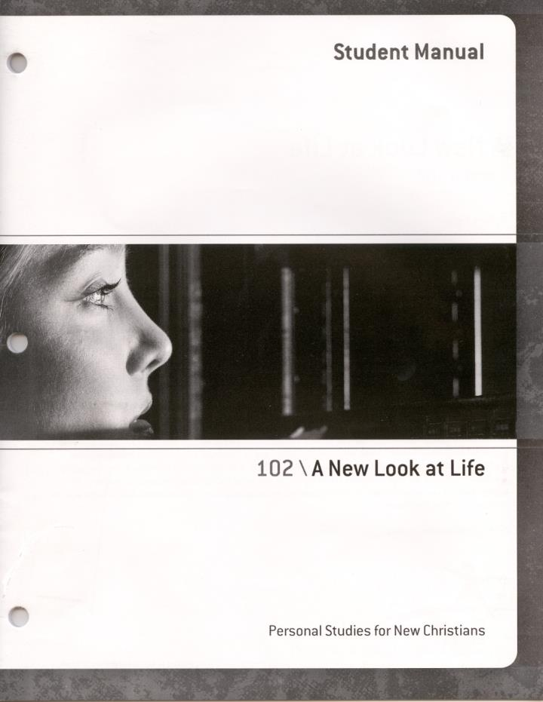
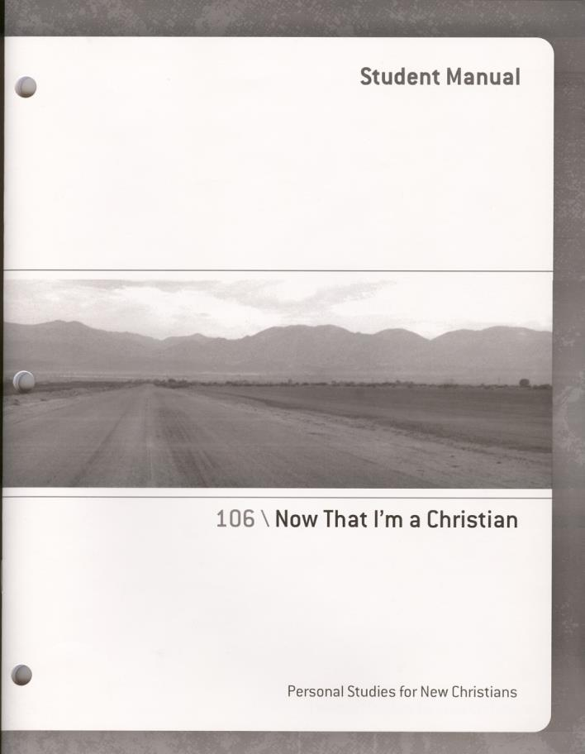
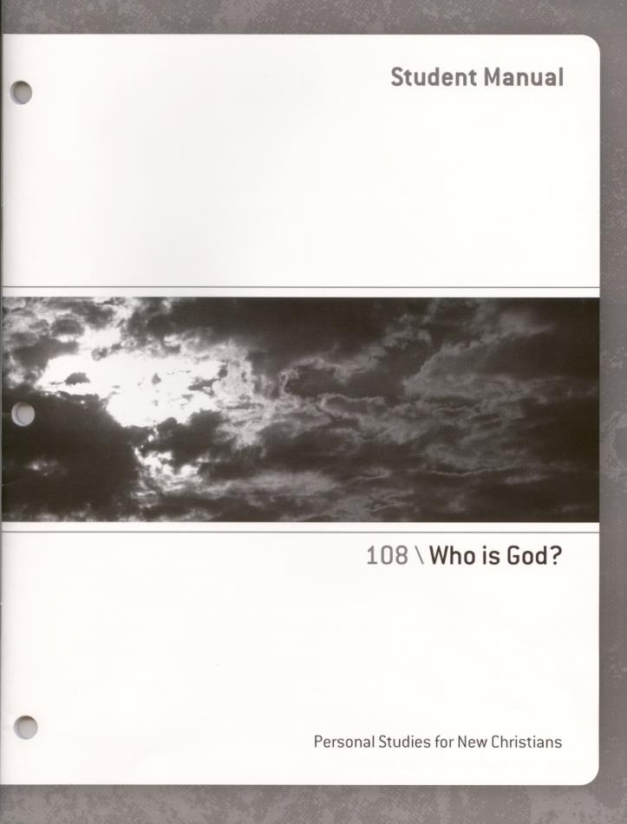

Slide 3
PSNC101: Does God have Plans for My World?
God has a plan for every life. No matter where one has come from, God has a direction for where they are going. This lesson will teach individuals the steps on how to uncover His perfect plan. Everyone needs direction on this journey of life; just consider this the map for the road ahead.

Slide 4
PSNC102: A New Look at Life
A New Look at Life will teach your students how to have a Biblical perspective about everything from family and friendships to work, stress, and temptation. Instill within them the desire to have God’s perspective in their lives, instead of that of the world.

Slide 5
Teacher’s Note for Lesson 102
The answer given by the student on page 16 of Lesson 102 directly influences which will
be their next lesson. The student has four choices on the bottom of page 16. There is a
lesson to follow up each one of these responses.
Below is a list of which lesson you
should give the student depending on the response they give you.
Next Lesson to give them
103 (3A 1. Yes, I want to become a Christian.
104 (3B) 2. No, I’m not ready to become a Christian
105 (3C) 3. I’m not sure if I am a Christian
106 (3D) 4. I am already a Christian.

Slide 6
Teacher’s Note for Lesson 102
Next Lesson to give them
103 (3A 1. Yes, I want to become a Christian.
104 (3B) 2. No, I’m not ready to become a Christian
105 (3C) 3. I’m not sure if I am a Christian
106 (3D) 4. I am already a Christian.
The answer given by the student can be discussed at the teacher’s signature point on the
bottom of page 17. In other words, before you sign that stop point, discuss with them the
answer they chose. If you think they should take a different lesson than the one suggested
above, feel free to improvise.
In most cases student would only do one of the 4 lessons 103-106. However, if a person
does lesson 104 and then decided to become a Christian, you may want to have them do
lesson 103 or 106.
You may also want to have students doing lesson 103 complete 106 next. Use your
discretion. Some students need to go over the same issue from a slightly different
perspective. Lesson 103, 105, and 106, all have some pages with are similar. They also
have certain sections which are unique to that lesson.

Slide 7
PSNC103: Yes! I Want to Become a Christian
By accepting Christ’s gift of salvation, your world becomes one of hope renewed and life restored. Learn how to take the initial step of accepting salvation, and what to do once you have made the commitment to follow Christ.

Slide 8
PSNC104: My Questions About Christianity
Do your students have questions that are keeping them from fully committing their hearts to the Lord? Becoming a Christian is a monumental decision, and not one that should be taken lightly. For individuals who still have reservations, this course is designed to address probing questions, and allow them to seek out the answers that could change their lives.

Slide 9
PSNC105: I'm Not Sure if I am a Christian
Doubts can eat away at the foundation of your relationship with Christ. But what should you do when such doubts won’t cease from entering your thoughts? This course takes an honest look at the doubts that can plague new believers, and offers tangible proof that can satisfy student’s questions.

Slide 10
PSNC106: Now That I'm a Christian
Where does one start when they’ve just been given a new lease on life? This lesson will teach how to share one’s testimony with others, how to pray more efficiently, and how individuals can begin to live the victorious Christian life..

Slide 11
PSNC108: Who is God?
Take a closer look at what the Bible says about God: Is there one God or many? What does He like, and what does God dislike? Issues of God’s character and personality are analyzed, with the Bible being the primary guide for this course.

Slide 12
PSNC109: God's Plan for the Family
In today’s turbulent society, it can be difficult to build and maintain healthy relationships. For some, this is particularly true in respect to their family. God has a design for every family and, as is seen in this course, marital, parental, and all other family relations can be strengthened and renewed by the strategies employed in God’s Plan for the Family.

