Slide 1
TEEN CHALLENGE
CORE VALUES
青年挑战核心价值观
Next Steps
核心价值观总结

Slide 2
Core Values Next Steps 核心价值观总结
Review these daily for at least one month. 每天复习这些内容，至少坚持一个月
Look for ways to express them in your daily activities. 在日常活动中寻找机会来表现这些价值观。
As you plan your day, ask, what opportunities will come to show one of these core values? 在你计划一天生活的时候，想一想会有什么机会能让你展示这些价值观？
Create a plaque to hang in your place of work with these core values listed, so when people see them and ask what they mean, you can tell them more. 制作一块牌匾放在你工作的地方。上面列举这些核心价值观。当人们看到并提问时，你可以告诉他们更多的知识。

Slide 3
Core Values Next Steps 核心价值观总结
Commit to living out the heart of Jesus in your life as you practice these core values. 以基督的心来实践这些价值观。
Pray specifically and ask God to help you see opportunities to demonstrate these each day.每天为此做专门祷告，请神帮助你看到能展示这些价值观的机会。
At your staff meetings each week, select one of these core values for the next week and challenge them to bring to the next staff meeting examples of how they have lived out this core value. 在每周的员工会议上，挑选一个价值观作为下周的实践目标。鼓励他们在下周的会议上分享实践经验。

Slide 4
Core Values Next Steps 核心价值观总结
Ask your staff and your family to hold you accountable so if you are acting without one of these core values, they will bring it to your attention. 请你的同工和家人监督你。如果你的行为中没有体现这些价值观，他们会提醒你。
Determine to use these core values in big decisions in your life. Ask yourself, How can integrity speak to this decision? 在你的生命中做重大决策时，应用这些价值观。问问自己，正直会如何评价这个决定？
At the end of the day, reflect on situations where you were able to use a core value. 一天结束时，回想一下你应用到了某个价值观时的情况。

Slide 5
Core Values Next Steps 核心价值观总结
Make one core value your target for a whole week, looking for ways to apply it in your life. 一周选定一个价值观作为目标，寻找实践它的机会。
Talk about these life examples of core values with your family, your co-workers. 与家人和同事谈论这些价值观的生活事例。
In your Bible study look for examples of these core values. 学习圣经时，寻找这些价值观的榜样。
Develop a notebook, a journal, or a file where you write down your experiences of living out each core value. 准备一个笔记本或文件夹，记录下你的实践经历。

Slide 6
Core Values Next Steps 核心价值观总结
With the staff you supervise, hold them accountable to use these core values in their work. 督促你所监管的员工在他们的工作中应用这些价值观。
Begin each day of work by reviewing one of the core values and challenging your workers to look for ways to use that core value today. 每天开始工作前回顾某一价值观，并鼓励你的员工当天寻找机会来应用那个价值观。
When dealing with problems at work, ask, which core value can provide assistance in dealing with this problem? 当处理工作中的问题时，问一问，那个价值观对处理这个问题有帮助？

Slide 7
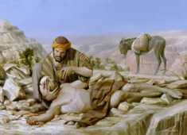
Core Values Next Steps 核心价值观总结
Write down insights on the deeper expressions of each core value. Become an expert at using these core values in your daily life. 对每个价值观写下你的见解。成为每天应用这些价值观的专家。
Do a study of how Jesus lived out each of these core values. 研究一下耶稣是如何活出每一个价值观的。
Do a study of what your life is like in living out the opposite of each core value. 研究一下如果你按照与这些价值观相反的价值观去生活，那么你的生活会是什么样子？
Teach a class on each of these core values. The planning and preparing for this will help you understand it better. 针对每个价值观讲授一课。备课的准备工作会使你对此价值观有更深的认识。

Slide 8
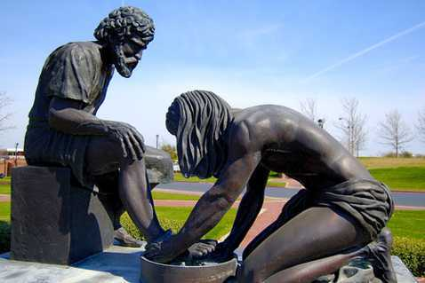
问题讨论

Slide 9
Contact: 联系：
Global Teen Challenge 全球青年挑战
gtc@globaltc.org
Training materials for this course are available at the following address: 培训教材可以在如下网站查询：
www.iTeenChallenge.org
www.globaltc.org

Slide 10
www.Globaltc.org
www.iTeenChallenge.org

