Slide 1
I Have A Dream Capturing and Implementing a God-Given Vision by EQUIP Ministries founded by John Maxwell
1

Slide 2
I Have a Dream Capturing and Implementing a God-Given Vision
“All these people died in faith, not having received the tangible fulfillment of the promises, but having seen them, and welcomed them by faith.”
(Hebrews 11:13)
2

Slide 3
I Have a Dream Capturing and Implementing a God-Given Vision
WHAT IS VISION?
It would be difficult to separate leadership from vision. All good leaders are driven by vision. They are not satisfied with maintaining the status quo. They long to take their ministry somewhere. But just what is vision? Some have attempted to define it below…
“Vision is seeing the future, in the present, built on the past.”
“Vision is seeing the invisible and making it visible.”
“Vision is an informed bridge from the present to a better future.”
3

Slide 4
I Have a Dream Capturing and Implementing a God-Given Vision
For our purposes, let me suggest the following definition for you to consider:
A clear mental picture of a better tomorrow, given by God, which moves a person to believe that it not only could be done, but it should be done.
4

Slide 5
I Have a Dream Capturing and Implementing a God-Given Vision
Robert Greenleaf, in his book, The Servant as Leader, says, “Foresight is the ‘lead’ that the leader has. Once he loses this lead and events start to force him to act, he is a leader in name only. He is not leading; he is reacting to immediate events and he probably will not remain the leader.” People long for leaders to give them hope – a picture of where they should go.
5

Slide 6
I Have a Dream Capturing and Implementing a God-Given Vision
Vision is a picture held in your mind’s eye of the way things could or should be in the days ahead. Vision is a portrait of a preferred future. The picture is internal and personal. Eventually, you will have to paint this mental portrait inside others if you wish the vision to materialize in your ministry. Just as God has used your imagination to create this view of the future, you will have to help others catch the same vision inside of them – so that they can share in its implementation.
6

Slide 7
I Have a Dream Capturing and Implementing a God-Given Vision
Note the Ingredients of a Divine Vision:
A clear picture. (It serves as a sort of map on the inside.)
A positive change. (It improves present conditions by introducing God’s Kingdom.)
A future focus. (It furnishes direction to the unseen future.)
A gift from God. (It is divinely inspired, not humanly manipulated.)
A Chosen People and time. (It is for a select leader and group at a given time.)
7

Slide 8
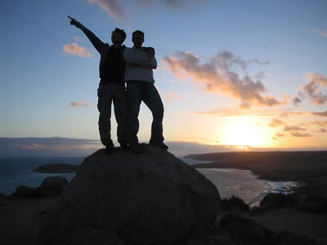
I Have a Dream Capturing and Implementing a God-Given Vision
Question: Have you ever been a part of catching and implementing a vision?
8

Slide 9
I Have a Dream Capturing and Implementing a God-Given Vision
The Birth of a Vision
For many leaders, their vision begins as an idea, without much detail or clarity.
As time passes, the idea turns into a major area of interest and soon becomes a passion.
It takes shape and forms inside of their minds and hearts. In many ways, the birth of a VISION is much like the birth of a CHILD. There are various stages it goes through as it matures.
Notice these stages on the next slides.
9

Slide 10
I Have a Dream Capturing and Implementing a God-Given Vision
The Birth of a Vision
In the same way that a husband and wife must join together to give birth to a son or daughter, a leader must experience _______ with God, in order to conceive a vision. People who catch a vision from God have spent time with Him in worship, quietness, solitude and reflection. This union provides God the opportunity to speak and reveal what He wants the leader to do. He plants the vision-seed inside you.
intimacy
10

Slide 11
I Have a Dream Capturing and Implementing a God-Given Vision
The Birth of a Vision
God may not communicate a vision every time you meet with Him. ___________ doesn’t occur every time a husband and wife come together. However, when God does reveal a vision to you, it comes in seed form and must grow inside of you. He plants the vision in you, and in the beginning it may still seem unclear, not fully formed. Remember this: God is the Husband, you are the bride of Christ. Just as a baby looks like both mom and dad, as the vision grows, it will look like God (it will be big and center around His priorities) and it will look like you (it will match your interests and gifts).
Conception
11

Slide 12
I Have a Dream Capturing and Implementing a God-Given Vision
The Birth of a Vision
This is the longest period of time in the process. It takes nine months for a child to be born. A vision from God may take even longer. During this time, the leader identifies with the problem, intercedes for the people, and intervenes in the process. The vision is forming inside the leader. When a baby is forming inside his mother, it changes the mother dramatically. So it is with a vision. God’s vision will stretch you, and you will never be satisfied again with a man-made idea.
Gestation
12

Slide 13
I Have a Dream Capturing and Implementing a God-Given Vision
The Birth of a Vision
This stage is often the most painful. Just prior to the birth of a vision, the _____ becomes hard. Similar to the birth of a child, the labor pains become more frequent and more intense. This is a sign the birth is near. So it is with a God-given vision. The Enemy often comes to steal the vision just before it comes to pass – bringing pain and struggle. The fight intensifies. He wants us to abort the vision. Don’t give up. Labor is a good sign that something is about to happen!
labor
13

Slide 14
I Have a Dream Capturing and Implementing a God-Given Vision
The Birth of a Vision
Finally, the vision is born. All that has been occurring inside the leader is ultimately realized. Everyone can see the fruit of the prayer, planning, and work. In fact, often many come to celebrate with you at this point, and you may wonder where they were when you were struggling to keep the vision alive! Don’t get angry. Let them celebrate with you, and invite them to help you parent the vision. The vision must now grow up and eventually stand on its own.
birth
14

Slide 15
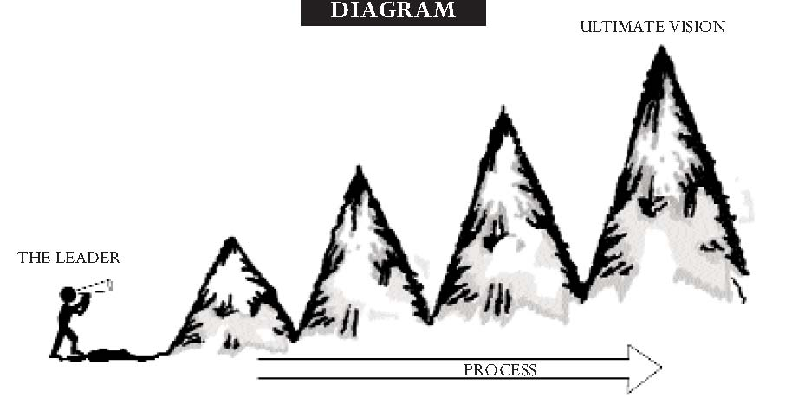
I Have a Dream Capturing and Implementing a God-Given Vision
Question:
What stage are you experiencing now?
15

Slide 16
I Have a Dream Capturing and Implementing a God-Given Vision
Man-Made Vision
You create it based on your gifts and skills
Its fulfillment rests on staying ahead of others
Other similar organizations are seen as competitors
Its goal is to build your organization and generate revenue
God-Given Vision
You receive it as a revelation from God
Its fulfillment rests on the leader’s obedience
Other similar ministries are seen as complementary
Its goal is to serve people, advance God’s rule and to honor God
16

Slide 17
I Have a Dream Capturing and Implementing a God-Given Vision
Steps to Fulfilling God’s Vision: Matthew 9:35-10:8
Matthew 9:35-10:8 marks a pivotal point in Jesus’ ministry. Until this point, Jesus was doing the ministry while the disciples watched. Read this passage and observe the process and strategy Jesus adopts as He fulfills His God-given vision. Christ models some steps for us to take today.
17

Slide 18
I Have a Dream Capturing and Implementing a God-Given Vision
Steps to Fulfilling God’s Vision
GET ACTIVE IN __________ AND INITIATE OBEDIENCE.
“Jesus went through all the towns and villages” (9:35a).
Jesus did not sit around by the Sea of Galilee waiting for ministry opportunities to come to Him. He was out, talking to people, entering their lives. He actively served people where they were. We must remember God usually shares His vision with those who are obeying what they already know to do.
SERVICE
18

Slide 19
I Have a Dream Capturing and Implementing a God-Given Vision
Steps to Fulfilling God’s Vision
COMMUNICATE THE ____________YOU HAVE ALREADY.
“Teaching in their synagogues, preaching the good news of the kingdom” (9:35).
Do you realize that you already know 95% of God’s will? “How?” you may ask. Open your Bible. God revealed 95% of His will for our lives there, yet we constantly badger Him for the other 5%, like who will be our mate, what career we will have or what is our future? God simply says: Obey what you already know, and then I will show you more.
REVELATION
19

Slide 20
I Have a Dream Capturing and Implementing a God-Given Vision
Steps to Fulfilling God’s Vision
_________ AND UNDERSTAND THE REALITY OF HUMAN CONDITIONS.
“When He saw the crowds” (9:36a).
Jesus was there among the people watching them. He saw the pained expressions on their faces and the physical ailments that afflicted them as they came to Him for healing. He stopped long enough to observe and understand their condition.
OBSERVE
20

Slide 21
I Have a Dream Capturing and Implementing a God-Given Vision
Steps to Fulfilling God’s Vision
ALLOW GOD TO ________YOU WITH A SPECIFIC NEED.
“He had compassion on them, because they were harassed and helpless, like sheep without a shepherd” (9:36b).
Jesus’ heart was moved. He felt pity for them and the condition they were in. This is how every vision begins: with a burden. You see something wrong, something that is not being done that should be done. From this a vision is born. When a heart is stirred by a need, that is when God imparts a vision to meet the need.
BURDEN
21

Slide 22
I Have a Dream Capturing and Implementing a God-Given Vision
Steps to Fulfilling God’s Vision
SEEK A DIVINE DIAGNOSIS: WHAT IS THE ___________________
“The harvest is plentiful, but the workers are few” (9:37).
Jesus saw the need: the people needed physical, emotional and spiritual healing. And then He identified the problem: there were not enough people to bring them the message of hope and healing. Jesus had been doing the work of healing by Himself up until this point. But there were more people with needs than He was able to touch. His diagnosis: big harvest, few workers.
ISSUE TO BE RESOLVED?
22

Slide 23
I Have a Dream Capturing and Implementing a God-Given Vision
Steps to Fulfilling God’s Vision
_____ TO DETERMINE WHAT ACTION COULD MEET THAT NEED.
“Ask the Lord of the harvest, therefore, to send out workers into His harvest field” (9:38).
So what did Jesus determine would meet the need? More workers! And that’s what He prayed for. Notice that He didn’t pray for bigger buildings or more money. The one action He prayed for was that God would send out more workers.
PRAY
23

Slide 24
I Have a Dream Capturing and Implementing a God-Given Vision
Steps to Fulfilling God’s Vision
CHOOSE A TEAM AND __________THEM FOR PARTNERSHIP.
“He called His twelve disciples to Him and gave them authority” (10:1).
Without a vision, the people perish. However, there is another truth we must grasp. Without people, a vision perishes. Jesus was not able to care for the needs of the people on His own. That was the problem. He needed more workers to join Him, to help Him fulfill His vision. So He formed a team and empowered them to help Him.
EMPOWER
24

Slide 25
I Have a Dream Capturing and Implementing a God-Given Vision
Steps to Fulfilling God’s Vision
___________________________TOWARD THE FULFILLMENT OF THE VISION.
“These twelve Jesus sent out” (10:5).
Jesus doesn’t hesitate a bit. He chooses a team and immediately sends them out with instructions on how to carry out His work. He imparts the vision and equips them with the tools to fulfill it. They become the answer to His prayer request for more workers.
TAKE IMMEDIATE ACTION
25

Slide 26
I Have a Dream Capturing and Implementing a God-Given Vision
What Voice Inspires Your Vision?
As you think about the vision you might pursue, remember that God uses a variety of “voices” to communicate with us. Consider how He has motivated you in the past. What methods has He used?
26

Slide 27
I Have a Dream Capturing and Implementing a God-Given Vision
What Voice Inspires Your Vision?
The Inner Voice: Does your vision come from life goals, mission statements or your personal desires? You won’t accomplish something you don’t believe in.
the Angry Voice: Does your vision come from dislike of a certain injustice or problem? Do you complain about the darkness or light a match?
The Successful Voice: Do you find your vision from people who have already gone through the same situation? Find someone who can be a mentor figure in your life.
The Higher Voice: A truly valuable vision is given from God. Look from the past to guide your present and future. Are you a big picture person or do you live life looking through a keyhole?
27

Slide 28
I Have a Dream Capturing and Implementing a God-Given Vision
Tools to Cast Your Vision . . .
Once you’ve captured the vision, you must find ways to communicate it to your people.
More than fifty years ago, Winston Churchill was a master at communicating vision to the British people during World War II. As Prime Minister, he developed a pattern that he used each time he communicated vision to his people.
28

Slide 29
I Have a Dream Capturing and Implementing a God-Given Vision
TOOL ONE: Strong Beginning
TOOL TWO: One Theme
TOOL THREE: Simple Language
TOOL FOUR: Pictures
TOOL FIVE: Emotional Ending
29

Slide 30
I Have a Dream Capturing and Implementing a God-Given Vision
Conclusion:
How We Must Handle Vision
1. See it _______.
2. Show it _________.
3. Say it _________.
Clearly
Creatively
Constantly
30

Slide 31
I Have a Dream Capturing and Implementing a God-Given Vision
ASSESSMENT: What has been your most difficult step as you’ve attempted to implement vision?
APPLICATION: How can you communicate your vision more effectively and biblically? What are some ways that you can create an environment where you can effectively capture and implement a God-given vision?
31

Slide 32
I Have a Dream Capturing and Implementing a God-Given Vision
“All these people died in faith, not having received the tangible fulfillment of the promises, but having seen them, and welcomed them by faith.”
(Hebrews 11:13)
Next Session: Priorities and Decision Making
32

Slide 33
For more information about this course and other training resources: Contact Global Teen Challenge at GTC@Globaltc.org Or visit our training website at iTeenChallenge.org

