Slide 1
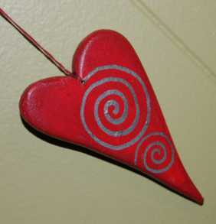
Sluknov, Czech Republic Wooden Crafts Started in 2008

Slide 2
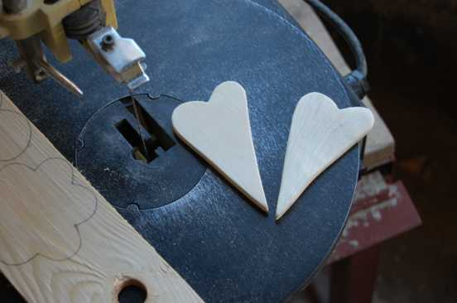
Project Overview
The project is based on the production of small souvenirs or ornamental items that we sell through public collections directly to people on the streets.

Slide 3
Key Roles
Role of Staff:
The role of the team is to conduct public collections and the coordination production of wooden hearts. A team (staff) member is always a part of the street sales.
Role of Students:
Students produce wooden hearts and also sell them in public collections. They are also sold in churches.

Slide 4
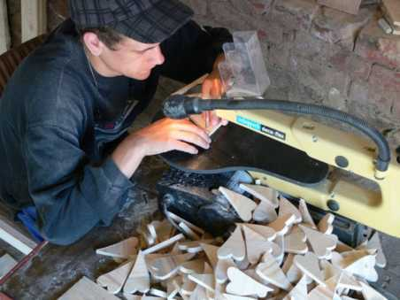
Time Requirements
How many hours of work per week are required in production/labor?
Production of some 1,000 wooden hearts will take about a month. Production involves 3-4 students for 6 hours/5 days.

Slide 5
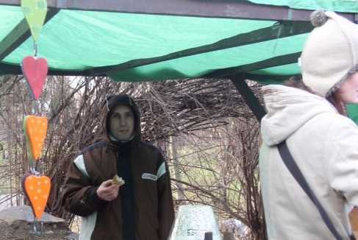
Time Requirements continued…
How many hours of work per week are required in sales/distribution?
The public collections require 3 students for 2 days a week. During these days they are able to sell about 500 hearts a month.

Slide 6
Start-up Specs
Initial Set-up time:
Requires only enough time to gather the tools and supplies, gain necessary permits for selling on the streets and for training students on making the crafts.
Time to produce a net profit:
Almost immediately (depending on what equipment you must purchase and the local market for sales)
Estimated set-up or start-up cost?
Less than $1500 USD

Slide 7
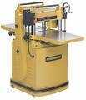
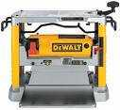
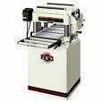
Supplies and Maintenance
Wood Planer
Planers come in a variety of sizes and can vary
greatly in cost

Slide 8
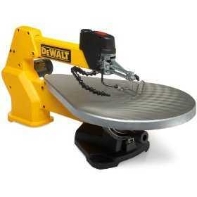
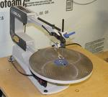
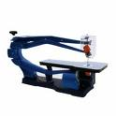
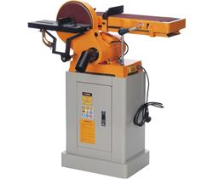
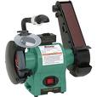
Supplies continued…
Scroll Saw
Combo Bench Grinder and Belt Sander

Slide 9
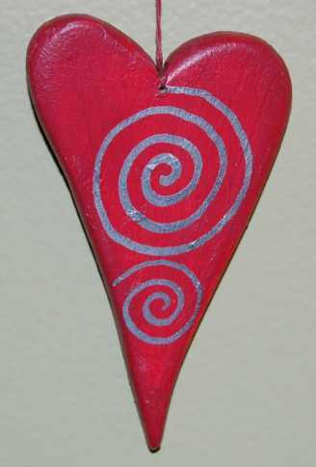
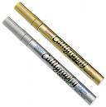
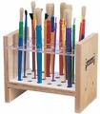
Supplies continued…
Colors (paint) for wood, wood varnish, brushes and special calligraphy paint markers for the ornaments

Slide 10
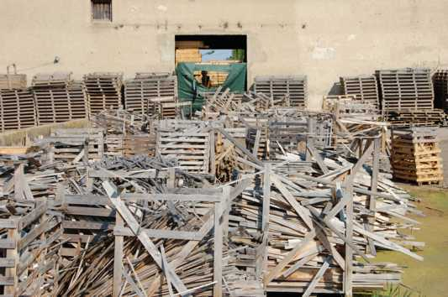
Supplies continued…
Wooden scraps – we get scraps for free from wood pallet factory
(Links to these tools can be found in Word Doc.)

Slide 11
Testimony
This project can raise resources to finance part of the costs of the program, but we also talk to people about our work and give them information about what Teen Challenge is doing for the community. Often they ask for help themselves. Students often have the opportunity to share the gospel with others! We believe in this project because it’s SO EASY! Easy to run (easy to learn how to make hearts, easy to be on the streets or market places), easy to make a profit, easy to give others information about TC and gospel, and we give something to people rather than just asking for money.

Slide 12
Things to consider before starting…
Be sure that you have the ability to reach people on the streets (make sure there is a market for such items). You may also consider producing objects other than the hearts, such as Christmas ornaments or anything that may work in your region.

Slide 13
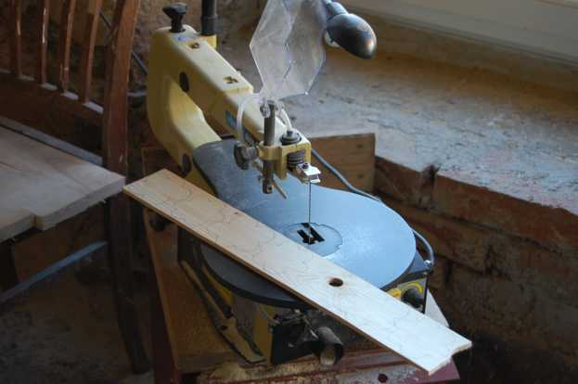
Problems with this project…
Probably the initial capital (money for equipment). Our advantage is that we are able to obtain free scrap wood suitable for processing.

Slide 14
What we’d do differently…
NOTHING! It works “as is”.

Slide 15
Marketing Strategy
For the hearts the strategy is simply consistently producing them and being on the streets to sell them. In general we are trying to diversify our projects and are growing businesses in building, metalworking and artificial stone manufacturing.

Slide 16
For more information on this project…
Contact:
Teen Challenge, men´s center in Sluknov, Czech Rep.
Director Petr Kral
petrking@gmail.com
+420777180549

Slide 17
Contact information
Global Teen Challenge
www.GlobalTC.org
www.iTeenChallenge.org

