Slide 1
TEEN CHALLENGE
CORE VALUES
Introduction
By Stephen Storms

Slide 2
Something they think has worth
Things like gold
diamonds
and houses

Slide 3
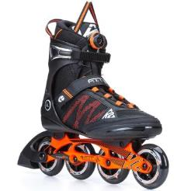
c. Things that contribute to their activities and goals
For example, a runner, a skater, and a soldier would value different kinds of footwear.

Slide 4
A priority – something that is important to a person
A key influence – something that gives guidance to everyday decisions and actions
A matter of the heart – something that is a personal conviction, something a person feels strongly about

Slide 5
A choice – something that a person chooses to make important
A source of unity – something that gives a group of people direction and purpose

Slide 6
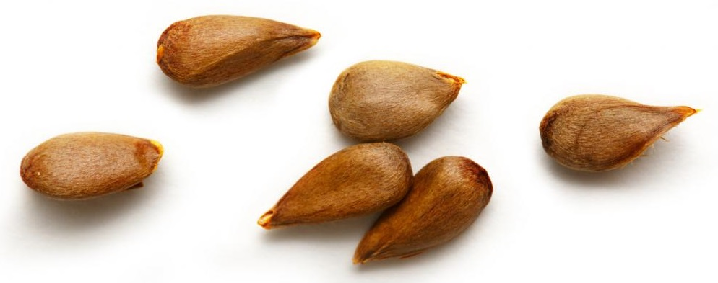
A legacy – something we want to pass on to future generations

Slide 7
For the Christian, a core value is something God values.

Slide 8
They provide focus. Hebrews 12:2 “Fix your eyes on Jesus.”
They provide boundaries. Hebrews 12:1 “the race marked out for us”
They provide a way to get rid of distractions. Hebrews 12:1 “Throw off everything that hinders”
They provide a goal and a reward. Philippians 3:14 “I press toward the goal to win the prize.”

Slide 9
Teen Challenge
Core Values
are introduced
in this book
by Jerry Nance,
Global Teen Challenge
President
It is available at
https://iteenchallenge.org/ resource/our-core-values-international-edition-pdf-5/

Slide 10
Servanthood
Integrity
Teen
Challenge
Core
Values
Compassion
Faith
Community
Stewardship
Vision

Slide 11
Why did Teen Challenge adopt these seven core values?
The mission of Teen Challenge is to bring people with life-controlling problems into relationship with Jesus and to disciple them to live out this relationship in every area of their lives.
In order to fulfill this mission, Teen Challenge staff members chose these seven qualities.

Slide 12
Why did Teen Challenge adopt these seven core values?
Because we are followers of Jesus, we want to value what He does.
Because we are followers of Jesus, these values are based on the Word of God.
Because we are followers of Jesus, these are the values we feel Him leading us to embrace.
We feel these qualities are central to the ministry of Teen Challenge.

Slide 13
How will these seven Teen Challenge core values become yours?
Realize these are values God wants you to have.
Let the Word of God and the Spirit of God personalize these values in your life.
Choose to make them a big part of your everyday decisions and actions.

Slide 14
We will consider these questions about Teen Challenge core values.
How are these core values defined?
How does the Bible teach these core values and which people in the Bible are examples of these values?
How do you develop these values?
How can you apply these values in a Teen Challenge setting?

Slide 15
We will consider these questions about Teen Challenge core values.
How do students from a background of drug addiction view these core values?
How can you help Teen Challenge students develop these values?
What have been your experiences in applying these values? What questions do you have about these values?
Where can you start today in growing these core values in your life?

Slide 16
Core Values Example:
Live the Southwest Way Warrior Spirit Servant’s Heart Fun-LUVing Attitude
Work the Southwest Way Safety and Reliability
Friendly Customer Service
Low Costs

Slide 17
Global Teen Challenge
www.globaltc.org
Training materials for this course are available at the following address:
www.iTeenChallenge.org

