Slide 1
Basic Elements of Christian Discipleship Training
By Dave Batty

Slide 2
A. Difference between birth and living
Physically
Physically not enough to bring baby home and give them a sheet of instructions
We are quite busy with our own lives and work
Have a great life!

Slide 3
A. Difference between birth and living
Spiritually
Do we give the new Christian a Bible and say “God bless you? We are glad to have you in the family of God.”

Slide 4
B. Life Training
Put off “old man”
Put on “new man”
Becoming like Christ

Slide 5
C. Three Basic Areas of Discipleship Training
Need for balanced growth in all 3 areas.
1. Christ-like lifestyle
Love, kindness, patience, qualities that describe Christian life. 2 Peter 1:5-8

Slide 6
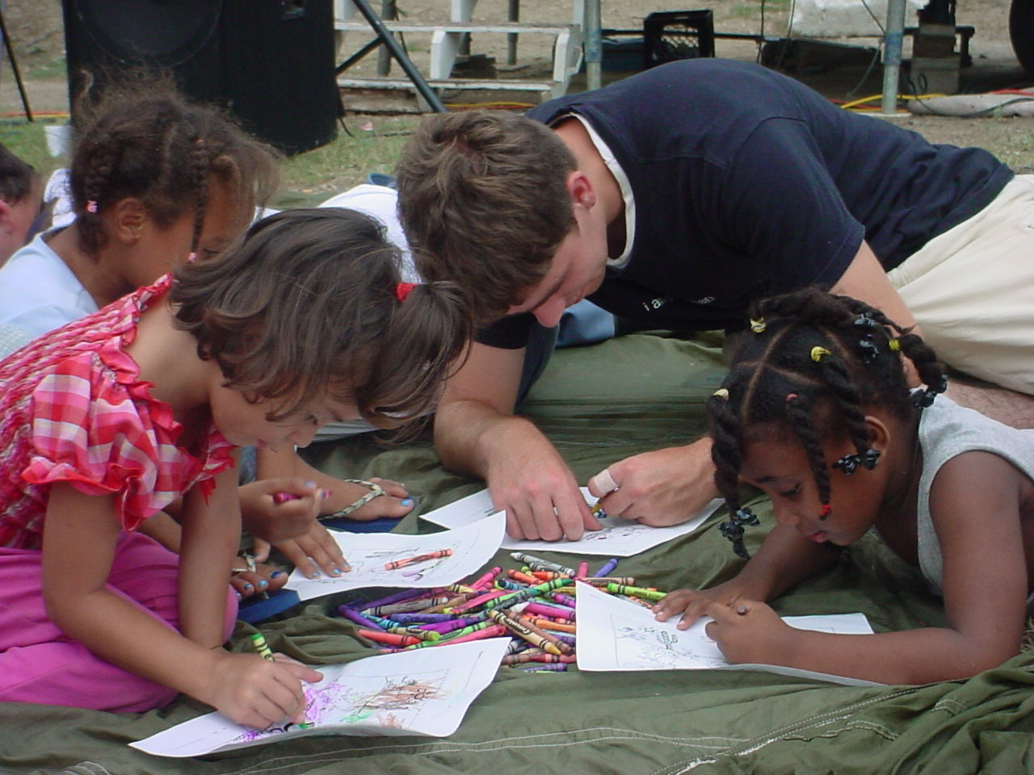
C. Three Basic Areas of Discipleship Training
2. Ministry of Christian service
Appropriate ministry for new Christians
Everyone is gifted 1 Cor. 12:18, Romans 12
Ephesians 4:11-16 – especially vs. 12 & 16

Slide 7
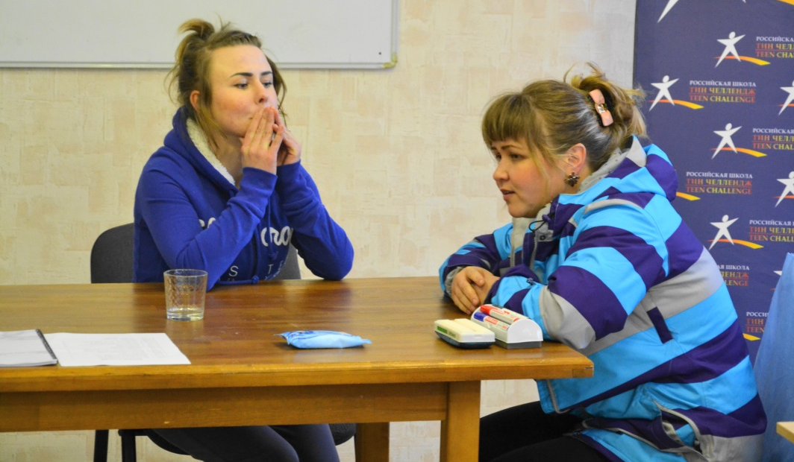
C. Three Basic Areas of Discipleship Training
3. Personal problem solving
We sometimes fail to understand the complication of past sins
Misuse of 2 Corinthians 5:17
Balance needed here

Slide 8
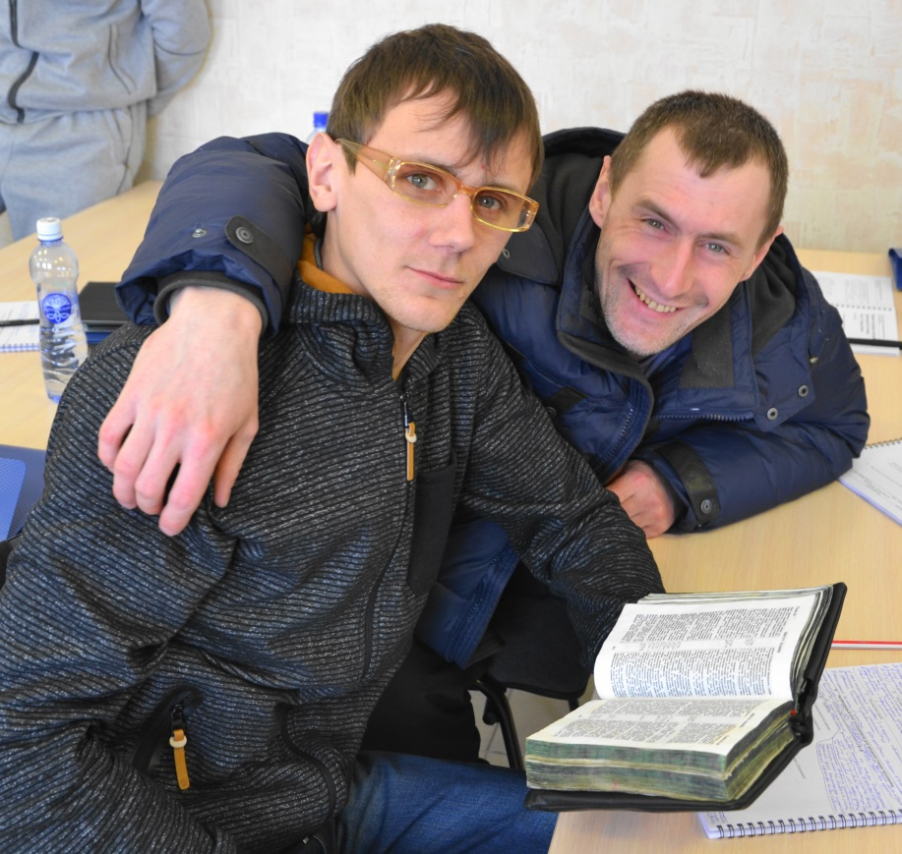
D. People are in search of meaningful relationships.
Culture today so busy
Time-saving devices

Slide 9
E. Focus is on application
Conclusion of sermon on the mount – Matthew 7:24-27
Wise man and the foolish man – in common – both heard the truth
Difference between them – One applied it – the other did not.

Slide 10
Difference between Education & Discipleship
Education Discipleship
Head vs Heart
Knowledge vs Application
Understanding vs Commitment
Letter of the law vs Spirit of the law
Legalism vs Life & Light

Slide 11
Philippians 3:14 I press toward the mark of the high calling of God.

Slide 12
Hebrews 12:1-2
Lay aside every weight and sin that so easily entangles and let us run with perseverance the race marked out for us – let us FIX our eyes on Jesus.

Slide 13
Questions for discussion

Slide 14
Contact us
www.Globaltc.org
www.iTeenChallenge.org

