Slide 1
Strategic Planning Failing to Plan Is a Plan to Fail by EQUIP Ministries founded by John Maxwell
1

Slide 2
Strategic Planning Failing to Plan is a Plan to Fail
“Give me wisdom and knowledge, that I may lead this people, for who is able to govern this great people of yours?
(King Solomon, II Chronicles 1:10)

Slide 3
Strategic Planning Failing to Plan is a Plan to Fail
The key to great planning is focus. Solomon did not ask for great riches or fame for himself, but rather he asked for wisdom so that he could lead God’s people. Solomon demonstrates a key aspect of leadership – knowing where you want to go before asking others to follow you. Once your personal and organizational mission is defined, the methods become easier to clarify as well. All great human endeavors have included a God-factor and a leadership factor. God has given us a mission that requires planning on our part as leaders.

Slide 4
Strategic Planning Failing to Plan is a Plan to Fail
Accomplishing the Mission
Do I have complete knowledge of my mission?
Do I have complete knowledge of my capabilities?
Do I have complete knowledge of my team’s capabilities?
Do I receive constant feedback and open communications?
Do I use this information to adapt and change when necessary?

Slide 5
Strategic Planning Failing to Plan is a Plan to Fail
Question: What is my mission?
____________________________________________________________________________________
Question: What has hindered me from accomplishing this mission?
____________________________________________________________________________________

Slide 6
Strategic Planning Failing to Plan is a Plan to Fail
Biblical Examples of Planning
God Did It…
“Have you not heard? Long ago I did it, from ancient times I planned it. Now I have brought it to pass.” (Isaiah 37:26)

Slide 7
Strategic Planning Failing to Plan is a Plan to Fail
Biblical Examples of Planning
Noah Did It…
Noah received explicit instructions from God to build the ark. God gave detailed measurements to Noah, and he was faithful to carry out the long-range plan. He finished construction of the ark, exactly as God told him – in 120 years. The ark was built so well that it withstood 40 days of torrential rain, and then it floated a solid year as the floods subsided. (Genesis 7-9)

Slide 8
Strategic Planning Failing to Plan is a Plan to Fail
Biblical Examples of Planning
Nehemiah Did It…
The long-range plan of Nehemiah was to see the wall of Jerusalem rebuilt. He visualized the completion of the wall and then began plans for its construction. The work was completed in 52 days because each family was assigned a certain portion of the wall to build. He planned and organized the project with excellence. (Nehemiah 1-5)

Slide 9
Strategic Planning Failing to Plan is a Plan to Fail
Biblical Examples of Planning
David Did It…
The long-range plan of David was to build a temple (II Samuel 7). God did not allow David to build it because of his associations with wars (I Kings 5:2-3). However, when Solomon was chosen to succeed him, David handed Solomon the completed plan for the temple and a list of materials on hand. After seven years of construction, the temple was completed, and the long-range plan of David was fulfilled.

Slide 10
Strategic Planning Failing to Plan is a Plan to Fail
Biblical Examples of Planning
Jesus Told Parables about It…
We often fail to notice that Jesus spoke about the necessity of planning and strategy frequently. In two of His parables, He explained how foolish it is to neglect planning:
The Wise and Foolish Builder: Matthew 7:24-27
The Builder Counting the Cost: Luke 14:28-30
The King Planning for Battle: Luke 14:31-32
The Unjust Steward: Luke 16:1-8

Slide 11
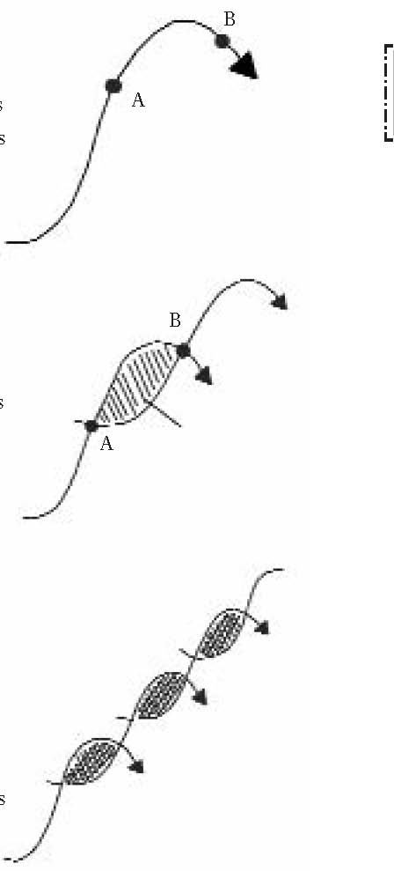
Strategic Planning Failing to Plan is a Plan to Fail
The Changing Future
The Growth Curve…
Charles Handy writes that most organizational growth occurs as the diagram illustrates to the right. Growth comes quickly (point A) but eventually peaks, and then decline sets in (point B). A leader must understand this, and make changes before the decline sets in. This means that a leader must begin change at point A.

Slide 12
Strategic Planning Failing to Plan is a Plan to Fail
The Changing Future
Anticipating Change and the Period of Chaos…
When change is initiated at point A, the followers will misunderstand what the leader is doing. When the change is made they often feel upset, resentful and in a state of flux. This is the “period of chaos” (the shaded area).

Slide 13
Strategic Planning Failing to Plan is a Plan to Fail
The Changing Future
Thriving on Chaos…
Because of the rapid change of pace in an organization, the leader must constantly be evaluating, planning and making healthy changes. This means followers may feel unsettled like they’re in a constant state of chaos. Great leaders and organizations must learn to thrive on this.

Slide 14
Strategic Planning Failing to Plan is a Plan to Fail
The Changing Future
Application…
Leaders must prepare their followers for the period of chaos early in the long-term planning process. Followers must be continually informed of what is going on in advance of the implementation of any plans. Gain the trust of followers by including them in the plans, giving them ownership of their part, and encouraging them through periods of chaos.

Slide 15
Strategic Planning Failing to Plan is a Plan to Fail
Steps to Effective Strategic Planning
1. PLAN TO ______.
A frequent mistake churches make is the failure to follow this step. A certain amount of time and energy must be allotted in the weekly agenda for the planning process. Everyone agrees strategic planning is important, but we often feel we’re wasting time when we take long hours to do it. The opposite is usually true. Look at the diagram below. When very little planning happens it takes more time for execution due to changes and unexpected events. When a good deal of time is spent planning, we may feel unproductive, but in the long run we will actually save time on the overall task.
– A Plan to Work Ratio –
PLAN
Time
The graph above is not a scientific formula, but rather a picture of what can happen when we spend time planning our actions.

Slide 16
Strategic Planning Failing to Plan is a Plan to Fail
Steps to Effective Strategic Planning
2. DETERMINE YOUR ___________________.
This involves big picture perspective. Before you can decide on daily agendas, you must determine what goal you want to reach. Strategic planning (long term) and operational planning (short term) both flow out of the answers to these questions:
Why Do We Exist?
What Are We Trying To Accomplish?
PRIMARY PURPOSE

Slide 17
Strategic Planning Failing to Plan is a Plan to Fail
Steps to Effective Strategic Planning
1. ________ THE SITUATION.
A plan for the future based on an unrealistic view of the present will lead to disaster. One way to verify that we are seeing the situation clearly is to look at it from different angles. Take our eyes for example. Two eyes give depth perception because each eye sees the picture from a different angle. In the same way we can have a clearer idea of our present situation when we look at it from more than one angle. Listed below are four angles to consider when assessing your situation.
– Angles of Assessment –
__________ the organization.
What are you doing from the perspective of those with whom you work?
__________ the organization.
What are you doing from the perspective of someone who does not know your strategy?
__________ point of view.
What does your situation look like from where you are now?
__________ point of view.
How does your situation look months or years from now? What TRENDS are developing?
Inside
ASSESS
Outside
Current
Future

Slide 18
Strategic Planning Failing to Plan is a Plan to Fail
Steps to Effective Strategic Planning
4. ____________ THE NEEDS.
List team goals in the order of importance and priority. Results are left to chance when needs are not prioritized. More often than not, the easy things will get done, but the important things will not. We tend to do the urgent things, but not the important. When the ultimate mission is neglected we become a slave to the immediate.
PRIORITIZE

Slide 19
Strategic Planning Failing to Plan is a Plan to Fail
5. ASK THE RIGHT ____________.
Target: Whom are we trying to serve and what needs are we meeting?
Leadership: Do we have the right people at the top to accomplish our goals?
Counsel: Whose advice do we need in order to succeed?
Direction: Exactly what are we going to do short-range, mid-range and long-range?
Organization: Who’s responsible for what? Who will supervise whom?
Funding: What are our expected expenses and income?
Reporting: Are we on target with our progress?
Communication: How can we effectively make known what we’re doing?
Evaluating: Are we seeking the quality we expect or demand from ourselves?
Refining: How can we keep improving in the critical aspects of this ministry?
QUESTIONS

Slide 20
Strategic Planning Failing to Plan is a Plan to Fail
Steps to Effective Strategic Planning
SET SPECIFIC _________.
Written - Write out on paper what you want to accomplish. It will serve as a daily reminder of what should be completed next.
Specific – A general plan may be easy to formulate, but objectives are easier to define when the goal is specific.
Realistic – Set goals you can reach. Though it may be exhilarating at first when you set lofty goals, we need to remember that a goal is only worthwhile if it is completed.
Measurable – A measurable goal is important because it allows you to evaluate how well you are doing.
Personal – Personal goals inspire and motivate you. They need to connect at the heart level and move you to act.
Convictional – You must be convinced of the worthiness of your goals. Only then will you invest in them.
GOALS

Slide 21
Strategic Planning Failing to Plan is a Plan to Fail
Steps to Effective Strategic Planning
7. _______________ AND CLARIFY.
Communication is sharing a vision of the objective that is to be accomplished. Clarification is showing the steps that need to be followed. This does not mean specifically telling someone what to do. Instead, it means giving him or her guidelines for completing the goal. Every planning meeting should include the items below.
a. Written conclusion d. Resource list
b. Project list e. Next steps (action items)
c. Time-line f. Responsibility (project leaders)
COMMUNICATE

Slide 22
Strategic Planning Failing to Plan is a Plan to Fail
Steps to Effective Strategic Planning
8. IDENTIFY POSSIBLE _________________.
The next step is identifying possible challenges. Think of obstacles that might occur so you can develop ways to overcome them. Imagine a “worst case scenario” and how you would respond. With planning and forethought, you can avoid many of the obstacles that would normally take up your time. When you take the time to plan, it will take less time to execute.
a. “The Mental Walk Through.” Mentally walk through the entire goal or event you are planning and note anything you might have forgotten.
b. “The Next Steps.” Determine the immediate action you must take to accomplish your goal. This is the most important result of any meeting.
OBSTACLES

Slide 23
Strategic Planning Failing to Plan is a Plan to Fail
Steps to Effective Strategic Planning
9. HAVE AN ______________ OF PLANNING.
Leaders must have an open system approach to planning that is aware of external influences. The decision-making and planning can adapt to these realities. A closed system attempts to exist with no regard to these outside factors.
OPEN SYSTEM

Slide 24
Strategic Planning Failing to Plan is a Plan to Fail
Steps to Effective Strategic Planning
10. _________ AND ________YOUR RESOURCES.
SCHEDULE – Put your items on a schedule that is responsible yet productive. Without a schedule, you can’t keep on track.
BUDGET – Determine the cost of the project, and at what point costs will be incurred. Attempt to remove any surprises you possibly can!
MANAGE
DIRECT

Slide 25
Strategic Planning Failing to Plan is a Plan to Fail
Steps to Effective Strategic Planning
11. ___________ AND ___________.
A river constantly changes and is never the same as it was before. Organizations are the same way. Regardless of how conscientiously plans are made, there is a constant need for monitoring and correction if the final destination is to be reached. Always have a plan, but have the understanding that the minute you stop adjusting and making changes your course will be altered and you will get off track.
MONITOR
CORRECT

Slide 26
Strategic Planning Failing to Plan is a Plan to Fail
Steps to Effective Strategic Planning
12. ________ THE RESULTS.
“Keeping score” is the only way to know if you’re winning or losing. Develop vehicles to keep score. If you’re making a change, you ought to do it based on current information.
STUDY

Slide 27
Strategic Planning Failing to Plan is a Plan to Fail
ASSESSMENT: What ministry idea is foremost in your priorities right now?
ACTION: Use the space below to begin the planning process for this project.

Slide 28
Strategic Planning Failing to Plan is a Plan to Fail
“Give me wisdom and knowledge, that I may lead this people, for who is able to govern this great people of yours?
(King Solomon, II Chronicles 1:10)
Next Session: TRACK TWO – The Leadership Test

Slide 29
For more information about this course and other training resources: Contact Global Teen Challenge at GTC@Globaltc.org Or visit our training website at iTeenChallenge.org

