Slide 1
Your Decision Determines Your Destiny Effective Leadership Requires Making Wise Decisions by EQUIP Ministries founded by John Maxwell
1

Slide 2
Your Decision Determines Your Destiny Effective Leadership Requires Making Wise Decisions
“I call heaven and earth to witness against you today, that I have set before you life and death, blessing and the curse. Therefore, choose life in order that you may live, you and your descendents.”
(Deuteronomy 30:19)
“Now, therefore, fear the Lord and serve him in sincerity and truth; and put away the gods which your fathers served beyond the river and Egypt, and serve the Lord. And if it is disagreeable in your sight to serve the Lord, choose for yourselves today whom you will serve; whether the gods which your fathers served which were beyond the river, or the gods of the Amorites in whose land you are living; but as for me and my house, we will serve the Lord. And the people answered and said, ‘…We will also serve the Lord.’”
(Joshua 24:14-21)

Slide 3
Your Decision Determines Your Destiny Effective Leadership Requires Making Wise Decisions
“I call heaven and earth to witness against you today, that I have set before you life and death, blessing and the curse. Therefore, choose life in order that you may live, you and your descendents.” (Deuteronomy 30:19)
“Now, therefore, fear the Lord and serve him in sincerity and truth; and put away the gods which your fathers served beyond the river and Egypt, and serve the Lord. And if it is disagreeable in your sight to serve the Lord, choose for yourselves today whom you will serve; whether the gods which your fathers served which were beyond the river, or the gods of the Amorites in whose land you are living; but as for me and my house, we will serve the Lord. And the people answered and said, ‘…We will also serve the Lord.’” (Joshua 24:14-21)

Slide 4
Your Decision Determines Your Destiny Effective Leadership Requires Making Wise Decisions
The Bible is clear about two fundamental truths.
First, God is sovereign. He reigns providentially over earth and its history.
Second, He has allowed us to choose whether we cooperate with Him in our leadership or not.
The prophet Jonah is a great example of both of these truths. He freely chose to run from God’s purposes. However, God ultimately persuaded him to return and fulfill His purposes in the end. In this lesson, we will examine the art of decision-making and how it affects not only our own lives, but the lives of those who follow us.

Slide 5
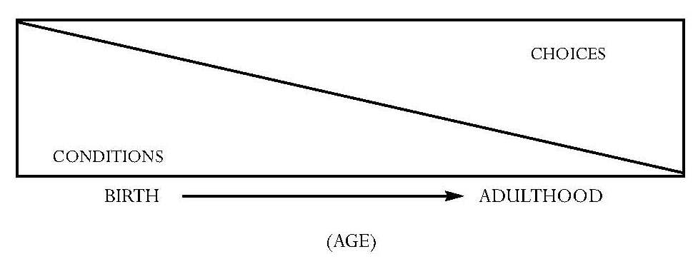
Your Decision Determines Your Destiny Effective Leadership Requires Making Wise Decisions
Conclusions about Our Choices
Leaders bring _______to a point of decision.
In some areas, we have no _______.
In some areas we do have a _______.
We are __________ to make right choices.
The ______ we make right choices the better.
Leaders make choices ____.
A leader’s choices ________ others.
people
choice
choice
responsible
sooner
first
influence

Slide 6
Your Decision Determines Your Destiny Effective Leadership Requires Making Wise Decisions
In our early years, our life is determined mainly by our conditions. A baby does not choose his family or environment. But as his age increases, so do his options. The difference between the conditions and choices is as follows:
Conditions Choices
___________________________________________________
___________________________________________________
___________________________________________________
___________________________________________________
The loneliest place in leadership is reserved for the person who makes the first decision.
The leader who will not make decisions creates insecurity among followers and a platform for potential leaders who recognize a decision must be made.
Early Life
Later life
Involuntary
Voluntary
Others choose
We choose
We react
We initiate

Slide 7
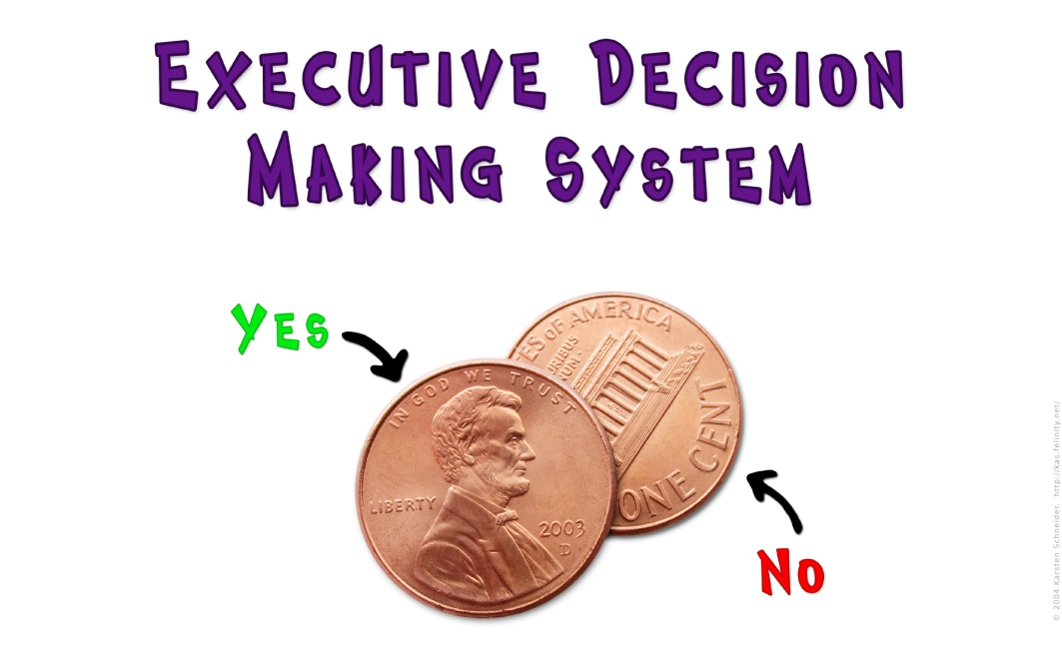
Your Decision Determines Your Destiny Effective Leadership Requires Making Wise Decisions
A CEO of a major international corporation once said: “95% of the decisions you make as a leader can be made by a reasonably intelligent teenager. They simply require common sense. However, you get paid for the other 5%.”

Slide 8
Your Decision Determines Your Destiny Effective Leadership Requires Making Wise Decisions
Six Phases of Decision Making
Once you recognize that good decision making is part of the territory of being a good leader, you should experience at least six phases in the decision making process:
_______________ – What is the history?
This is where you study to understand what has gone on before you arrived, and what is underneath the structure for which you are trying to make decisions. What have been the struggles in this organization? What have been the victories? What is the organizational culture? Why is it this way? What are the peoples’ goals and expectations?
Foundation Stage

Slide 9
Your Decision Determines Your Destiny Effective Leadership Requires Making Wise Decisions
__________ – What are the facts?
This is where you gather all the facts and information available to give you insight concerning the situation. Often there are at least two sides to every issue; be sure to discover what’s behind both sides of an issue. Your investigation will help you get beyond intuition and guesswork. You will have hard data to use in the decision making process.
Fact Stage

Slide 10
Your Decision Determines Your Destiny Effective Leadership Requires Making Wise Decisions
_______________ – What are the emotions?
This is where you ask for feedback from the people involved to hear where their heart is.
They will give you insight about both the situation and about how much the people are willing to give themselves to the decision. Effective leaders read their people before they lead their people.
Feedback Stage

Slide 11
Your Decision Determines Your Destiny Effective Leadership Requires Making Wise Decisions
______________ – What is the wise choice?
This is the key question in all decision making. Proverbs tells us that wisdom cries out in the streets…but few listen. When we are forced to make a decision, God’s wisdom almost always surfaces when we simply pose the question: what is the wise choice? The greatest difficulty in making decisions is not knowing the right decision but in making it.
At this point, you make a decision
Focus Stage

Slide 12
Your Decision Determines Your Destiny Effective Leadership Requires Making Wise Decisions
_________ – How can this decision bear fruit and be
successful?
This is where you focus on the problems that can hinder the decision and the procedure of communicating the decision to others. Once you determine the direction you believe is best, you need to think through possible obstacles and how to communicate with those who need to know. Successful leaders address potential problems before the followers ask.
Fruit Stage

Slide 13
Your Decision Determines Your Destiny Effective Leadership Requires Making Wise Decisions
______________ – When do we move?
This is when you stop talking about doing something and you act. You determine the right time to move forward and take a step. You are no longer wrestling with what step to take, but simply when to take it. Remember these important truths:
The wrong decision at the wrong time = ______________
The wrong decision at the right time = ________________
The right decision at the wrong time = ________________
The right decision at the right time = _________________
Forward Stage
disaster
mistake
unacceptance
success

Slide 14
Your Decision Determines Your Destiny Effective Leadership Requires Making Wise Decisions
A Process for Decision Making (James 1:1-8)
In James 1:1-8, we read a three-step process for making decisions. James tells us what to do if we lack wisdom yet face an important choice. Here are his three steps:
______________(v. 2-4)
We can find joy in the midst of problems only when we recognize their purpose and results. The key is perspective. Leaders must think correctly about problems. They must see them from God’s perspective so that their followers grow stronger through them.
Contemplation

Slide 15
Your Decision Determines Your Destiny Effective Leadership Requires Making Wise Decisions
_______________(v. 5)
God gives us struggles so that we will lack nothing in the end. James says, however, that if we lack wisdom, we should ask God for it. It is no sign of weakness for a leader to pray for wisdom when facing problems or big decisions.
_______________(v. 6-8)
If we do ask God for wisdom, we must ask in faith, expecting His answer. Once leaders gain perspective and trust God for wisdom, the only thing left to do is to anticipate solutions and express optimism.
Question: What is one decision you face that you feel you don’t have the wisdom to make?
Supplication
Anticipation

Slide 16
Your Decision Determines Your Destiny Effective Leadership Requires Making Wise Decisions
Decision Making in the Gray Areas (I Corinthians 10:24-33)
Leaders regularly face choices that affect not only their own lives, but many others.
What’s more, many of these decisions have no clear answer; they do not appear black and white, but gray.
So, how does a leader make good decisions in the gray areas?
Paul describes a system for making tough decisions like this.

Slide 17
Your Decision Determines Your Destiny Effective Leadership Requires Making Wise Decisions
_____________________
Leaders must not make decisions based upon what benefits them the most. The term “others” in this Scripture refers to people who are “unlike you.” They are different and are not likely to see the issue as you do. Leaders must choose what is best for others, not what appeals to their own tastes. Ask yourself: Who will benefit most from this decision?
Prioritize God’s People

Slide 18
Your Decision Determines Your Destiny Effective Leadership Requires Making Wise Decisions
__________________
Does the decision glorify God or someone else? Paul would agree with the shorter catechism, “the chief end of man is to glorify God and to enjoy Him forever.” All big decisions should somehow bring honor to God. Ask yourself: Does this decision give people a better picture of who God is?
Pursue God’s Glory

Slide 19
Your Decision Determines Your Destiny Effective Leadership Requires Making Wise Decisions
_____________________
The ultimate purpose for our being here on earth is to bring others to Christ. While leaders may have many small goals, this is the ultimate goal. We must always move toward fulfilling this mission. Ask yourself: Will this decision please God and fulfill His purposes?
Perceive God’s Purpose

Slide 20
Your Decision Determines Your Destiny Effective Leadership Requires Making Wise Decisions
Principles on Decision Making
Choice, not chance, determines my ________.
Notes…
To choose not to decide is to choose to let ____________control my life.
Notes…
To choose to decide is to take ____________.
Notes…
Indecision is the mark of a _______ mind.
Notes…
Decisiveness is the mark of a _______.
Notes…
Followers can live without certainty, but they cannot live without ______.
Notes…
destiny
someone else
responsibility
fearful
leader
clarity

Slide 21
Your Decision Determines Your Destiny Effective Leadership Requires Making Wise Decisions
The leader who ______ on perfect knowledge before he decides, never decides.
Notes…
Decisions _______ energy, insight, commitment and support.
Notes…
The larger the group of followers, the greater the ________ to conform.
Notes…
Great people are ordinary people who make extraordinary _________.
Notes…
Decisions should be made at the ______ level possible in an organization.
Notes…
Success is not for the chosen few, but for the few who _______.
Notes…
insists
release
pressure
decisions
lowest
choose

Slide 22
Your Decision Determines Your Destiny Effective Leadership Requires Making Wise Decisions
ASSESSMENT: What decisions in your leadership do you hesitate to make?
Why do you hesitate? What makes decisions difficult to make?
APPLICATION: List two action steps you can take to make better decisions.
___________________________________________________
___________________________________________________

Slide 23
Your Decision Determines Your Destiny Effective Leadership Requires Making Wise Decisions
“I call heaven and earth to witness against you today, that I have set before you life and death, blessing and the curse. Therefore, choose life in order that you may live, you and your descendents.”
(Deuteronomy 30:19)
“Now, therefore, fear the Lord and serve him in sincerity and truth; and put away the gods which your fathers served beyond the river and Egypt, and serve the Lord. And if it is disagreeable in your sight to serve the Lord, choose for yourselves today whom you will serve; whether the gods which your fathers served which were beyond the river, or the gods of the Amorites in whose land you are living; but as for me and my house, we will serve the Lord. And the people answered and said, ‘…We will also serve the Lord.’”
(Joshua 24:14-21)
Next Session: Track Six – Today Matters

Slide 24
For more information about this course and other training resources: Contact Global Teen Challenge at GTC@Globaltc.org Or visit our training website at iTeenChallenge.org

